Slide 1

The Essential
Agreement
THRIVE Lessons

Slide 2
Learning Objectives
Understand why making mistakes is essential.
Define real-time resilience.
Practise using evidence, optimism and perspective strategies.
Apply RTR to a real-life situation.
In today’s lesson, you will…

Slide 3

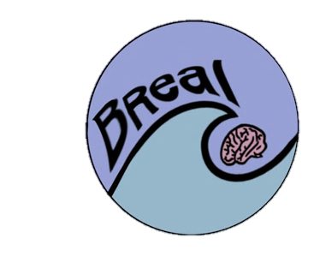


Building stress resilience in early adolescents’ lives

Slide 4

What does this quote mean about resilience ?

Slide 5


Learning from mistakes
Fear of making mistakes can stress people out and stop them from solving problems. But to learn, making mistakes is essential! – this is how brains adapt to do better next time. Bouncing back!

Slide 6



Phase 1: Learning a new skill
When people learn anything new, like surfing, they will fall off their surfboard as often as they stay on.
These experiences of success and mistakes act as rewards and errors that help them change their behaviour over time.
How could they stand next time?
Phase 2: Practising a skill
Once people have figured out the basic successful strategy it’s now time to go from beginner to advanced level. They can do this by practising! Over time they will:
- Make fewer mistakes.
- Get faster and more efficient.
How do people learn
from successes
and mistakes?

Slide 7



It is important to try things out when learning ……
Practice makes progress.
But it's important to stay flexible too...
This is because:
The best choices aren’t always clear.
The best choices can change over time.
The best choice for now might not always be the best.
Did you know?
Even super "intelligent" computers are programmed to make mistakes and learn from them!

Slide 8

Mindset to support learning
VS
Learning well from mistakes takes the right attitude.
Growth mindset says…
‘mistakes are nothing to be ashamed of’
‘mistakes help me learn’
‘If I practice and put in the effort, I can succeed’. ​
Fixed mindset says…
‘I’m a loser’
‘I’m rubbish’​
‘I’ll never be any good’
‘If I keep trying, I’ll just keep failing’

Slide 9


Ernie Els six putt
Even a former world number one golfer like Ernie Els can struggle mentally. After his infamous six-putt at the Masters, he said:
"I couldn’t take the putter back"
"I had snakes in my brain"
"I might need a brain transplant"
This reminds us that even the top professionals can get caught up in mental struggles.
Notes:
https://youtu.be/lXcG6GcH4zo?si=wHX6iRMwRqUFXFsb

Slide 10


What is real-time resilience?
Real-Time Resilience (RTR) is a strategy that helps manage unhelpful thoughts by :
using evidence to counter them
fostering optimism to see situations more positively
putting challenges into perspective to reduce their impact
………..enabling a calmer and more effective response to stressful situations.
Notes:
https://youtu.be/mC3FpTBamzs?si=ivOkja3Ll9Qq_N9t

Slide 11
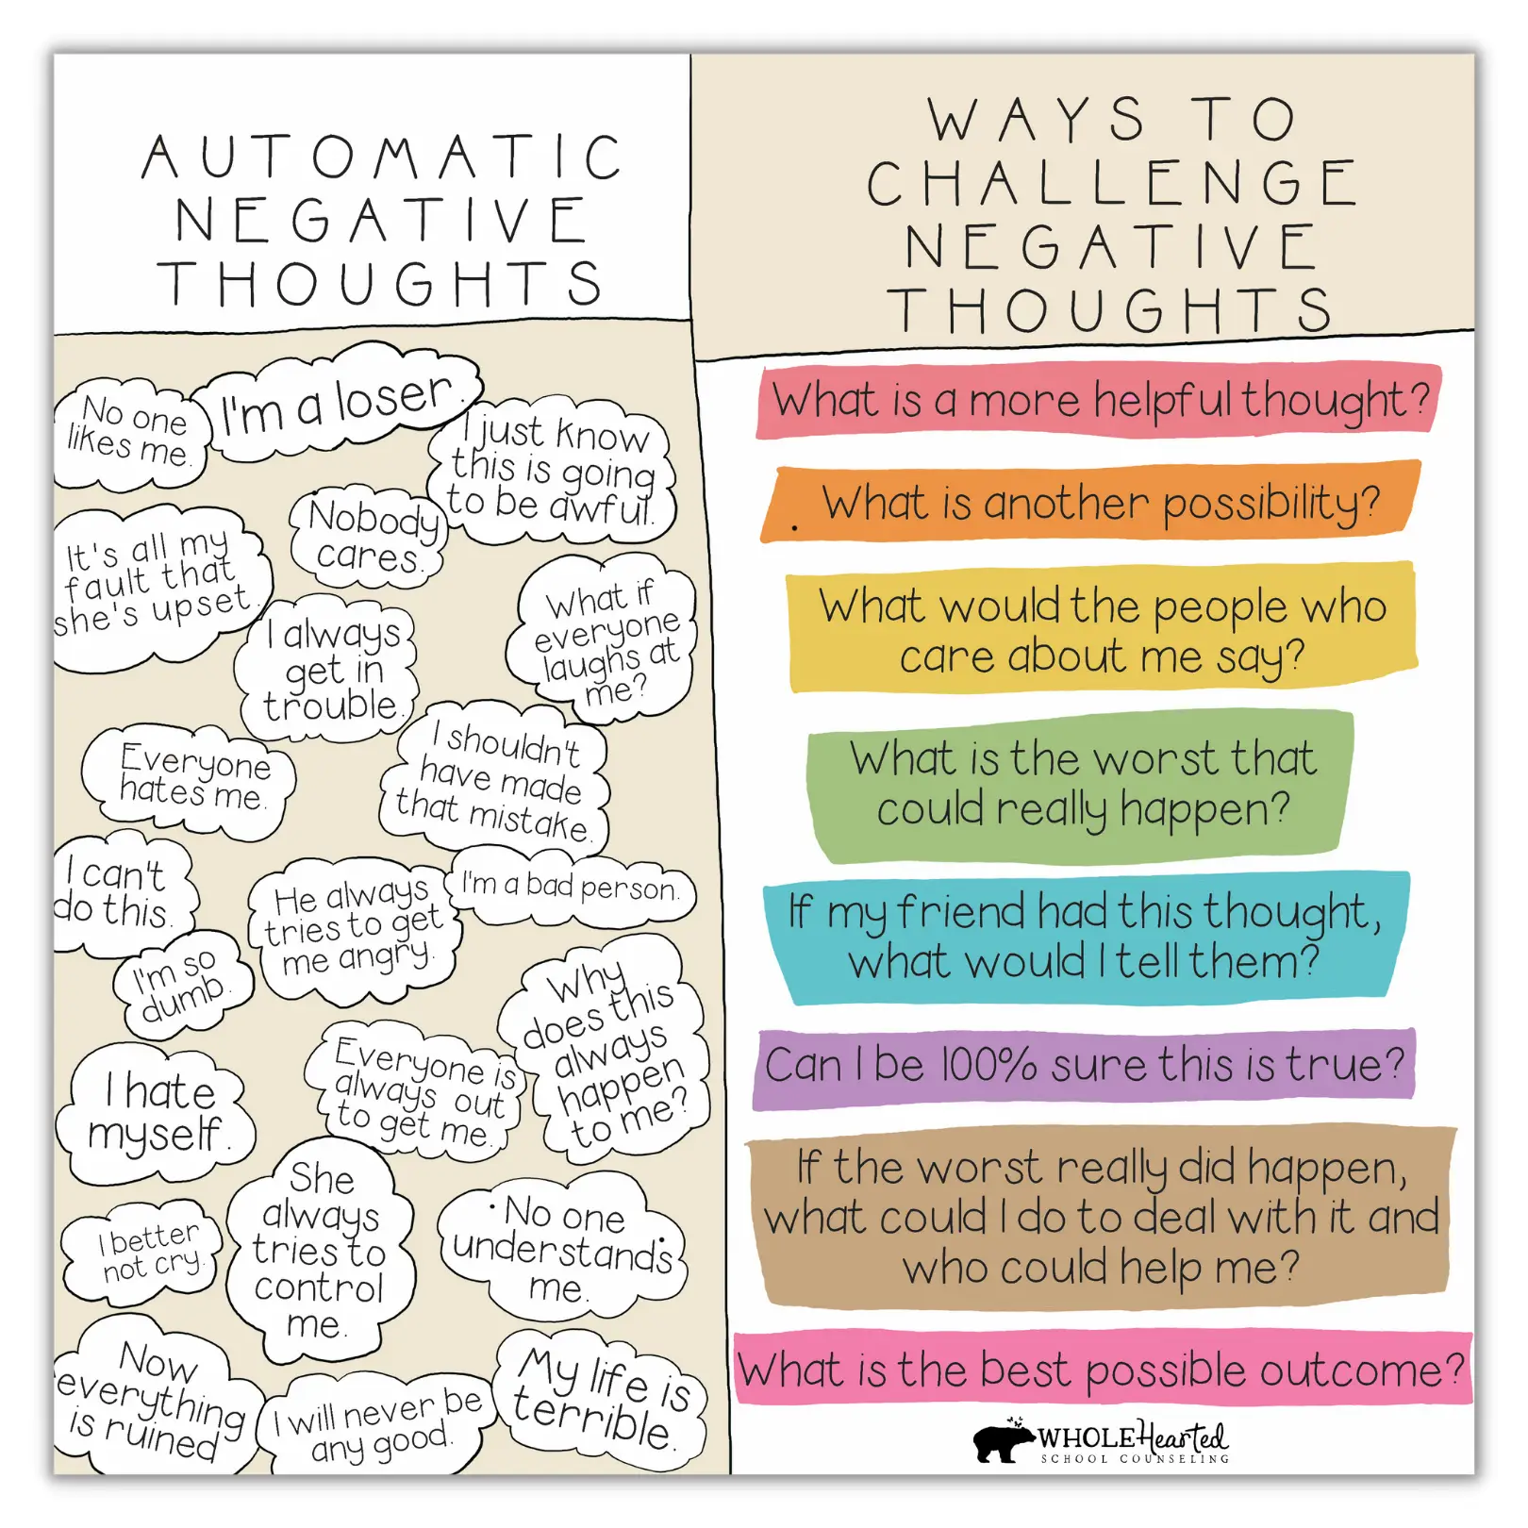
Voices in your head...
Have you ever had a similar experience where negative and positive thoughts fought inside your head?
We all have moments of self-doubt in stressful situations where we have many varying thoughts in our minds. RTR is a skill designed to fight the negative or counterproductive thoughts in the moment and take us to a place of self-confidence.

Slide 12

REVIEW STARTER ACTIVITY
At Resilience Mindset, we believe that resilience is a muscle we can all build and some of the best teachers are those who’ve lived through the toughest trials and still kept going.

Slide 13

RTR strategies #1
Evidence/Acknowledge
Helps you challenge negative thoughts by looking for facts that prove those thoughts are inaccurate.
Imagine you think, "I’m going to fail this test." Using the evidence strategy, you remind yourself that you’ve studied and passed similar tests before, proving your thought wrong.= Evidence !

Slide 14
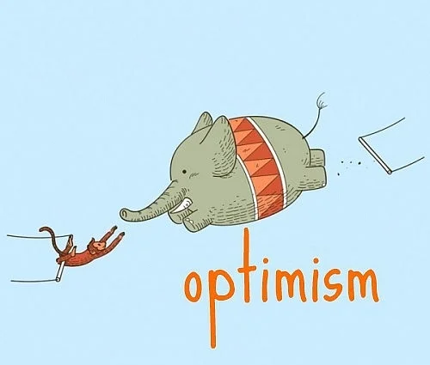
RTR strategies #2
Optimism / Perspective
Optimism involves shifting your mindset to view the situation more positively.
If you’re nervous about a presentation, think, "This is a chance to show what I know," rather than focusing on what could go wrong.
Shifting perspectives help reduce stress by allowing you to realise that the current situation might not be as big or bad as it seems.
If you make a mistake in a sports match, instead of thinking, "I’ve let my whole team down," remind yourself that one mistake doesn’t decide the outcome, and everyone makes errors.

Slide 15
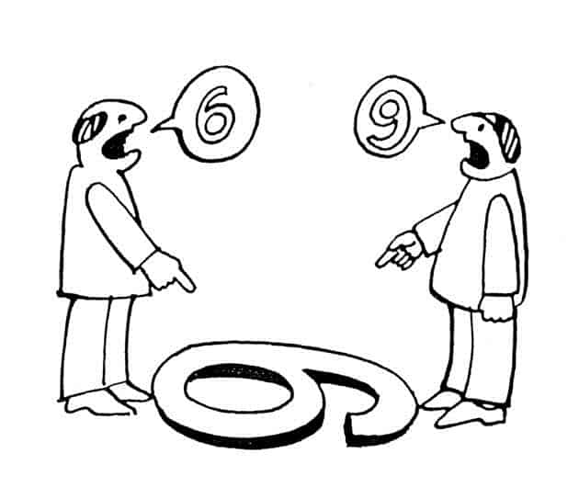
RTR strategies #3
Action
Moves the brain out of the "freeze/flight" state and back into agency and self-efficacy. Real-time resilience requires doing, not just thinking.
What is one small thing I can do right now to move forward?
“I am going to highlight three topics I got wrong and ask the teacher for help during lunch."

Slide 16
Speed dating w RTR (rotate every 30 seconds)
VS
Outside circle - high stress scenarios
‘I failed my mock exam’
‘I’m just not an academic person’
‘My friend group went out without me. Nobody likes me’. ​
Learning well from mistakes takes the right attitude.
Inside circle - resilience coach
You have 30 secs to offer a growth-mindset reframe OR rtr counterstatement.

Slide 17
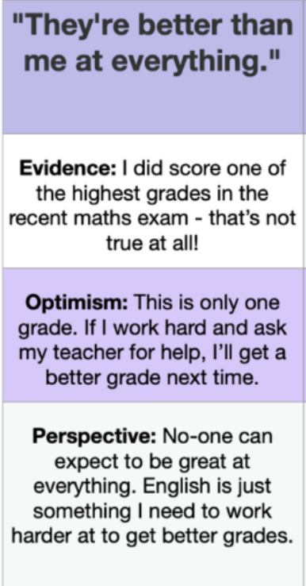
EXAMPLE

Slide 18
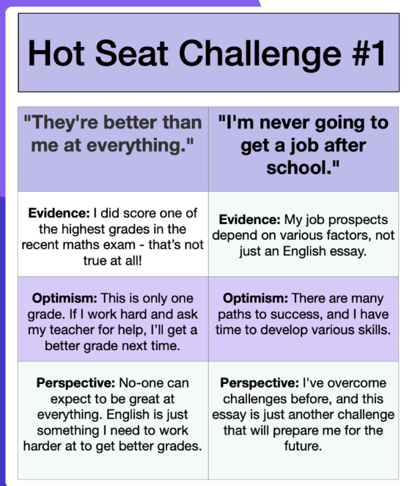
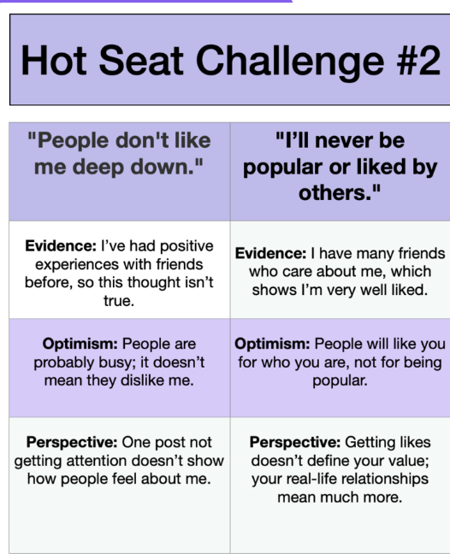

Slide 19

Real-time resilience is a powerful tool for managing counterproductive thoughts by applying evidence, optimism, and perspective. It helps us stay grounded and respond more effectively to challenges by reframing negative thinking. By consistently applying these strategies, we can improve our mental resilience and face life’s challenges more confidently.

Slide 20
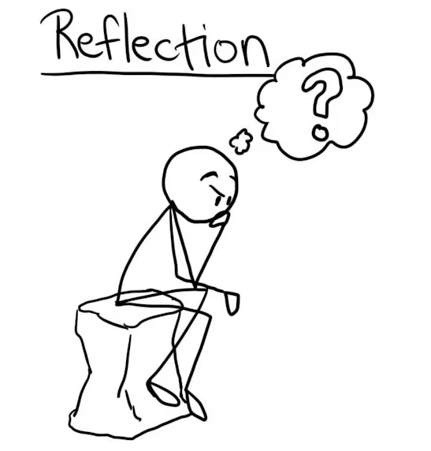
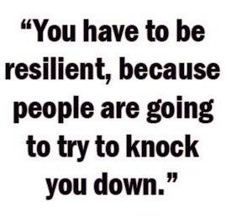

Notes:
https://youtu.be/vyYDz_A6HO8?si=thrR_cEH6_u8_Lvf

Slide 21
Requirements: The message must include:
One fixed mindset thought you know you tend to fall into.
A reframe using the RTR strategies (Acknowledge, Reframe, Action framework.)
One specific grounding action (e.g., "Take 3 deep breaths," "Talk to Alex," "Re-read chapter 2").
Send a text message to yourself
Draft 3 text message addressed to their future self, to be read during a high-stress moment (e.g., during mock exams or after a social disagreement).

Slide 22
Example text message:
“Hey me, if you're stressing about math right now, remember you don't suck at it, you just haven't mastered calculus YET. Put the phone down, do 5 minutes of review, and ask Mr. Davis tomorrow."

Slide 23
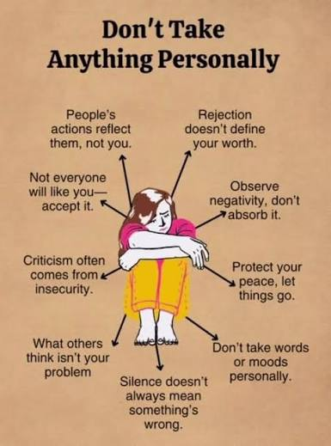
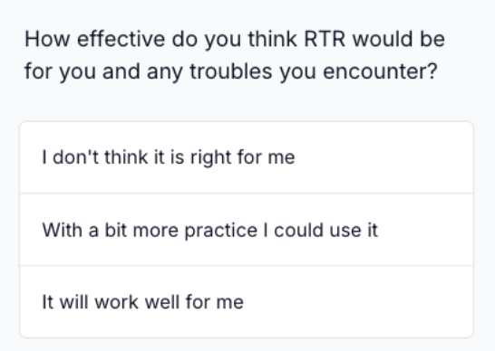
FINAL THOUGHTS
Try and apply the Real -Time Resilience over the next week.

